Slide 1
Capstone Project case study
Indian Restaurants In Al Karama Neighborhoods

Slide 2
Introduction: Business Problems
In this project we will try to find an optimal location for a restaurant.
Specifically, this report will be targeted to stakeholders interested in opening an Indian restaurant in Karama, Dubai, U.A.E.
We are also particularly interested in areas with no Indian restaurants in vicinity.
We would also prefer locations as close to city center as possible, assuming that first two conditions are met.
We will use our data science powers to generate a few most promising neighborhoods based on this criteria.

Slide 3
Data
Google Maps API geocoding
Foursquare API
Google Maps API reverse geocoding
Neighborhood Candidates

Slide 4
Methodology
In first step we have collected the required data
Second step in our analysis will be calculation and exploration of 'restaurant density' across different areas
In third and final step we will focus on most promising areas and within those create clusters of locations

Slide 5
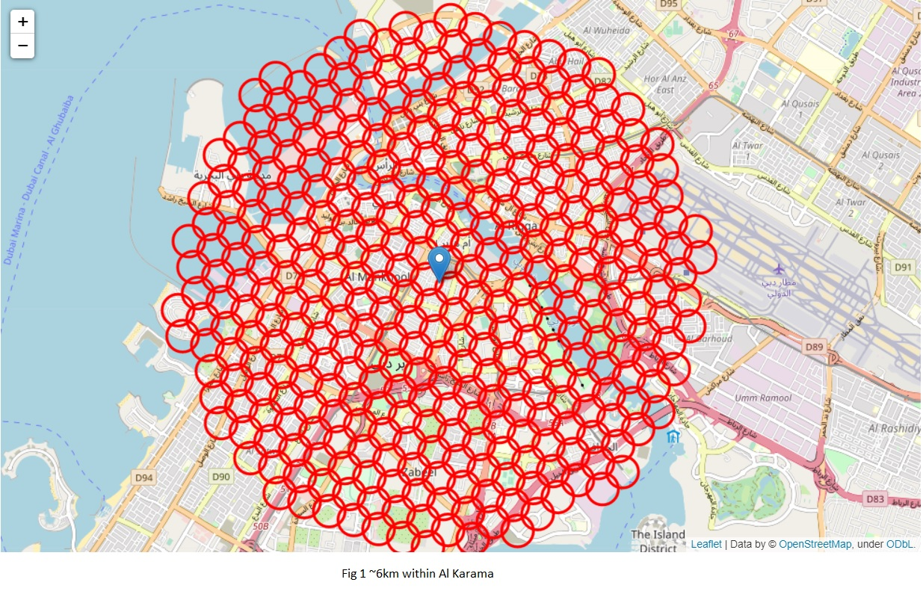
coordinates of centers of al karama neighborhoods

Slide 6
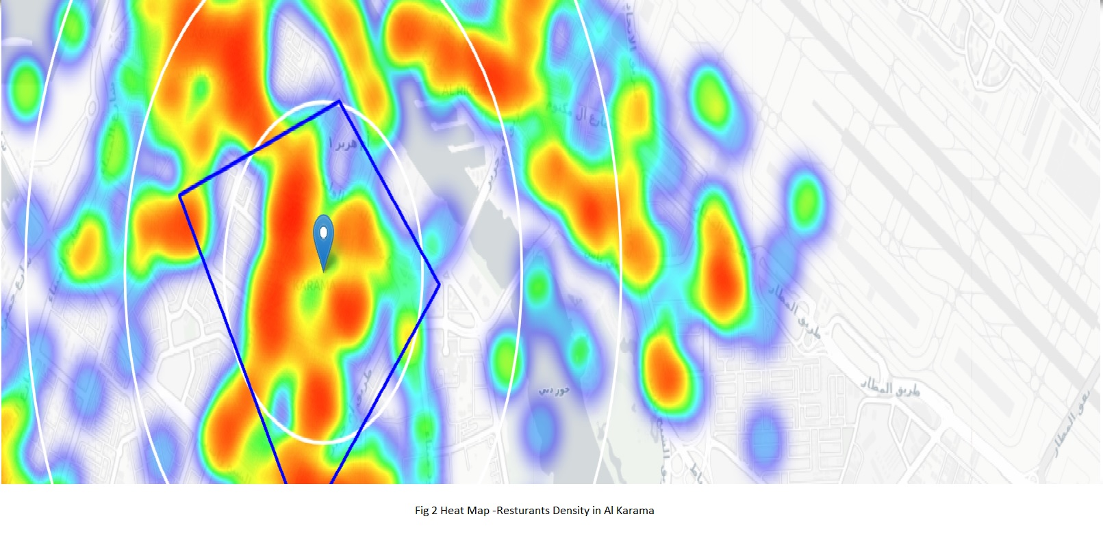
Analysis- basic explanatory data analysis

Slide 7
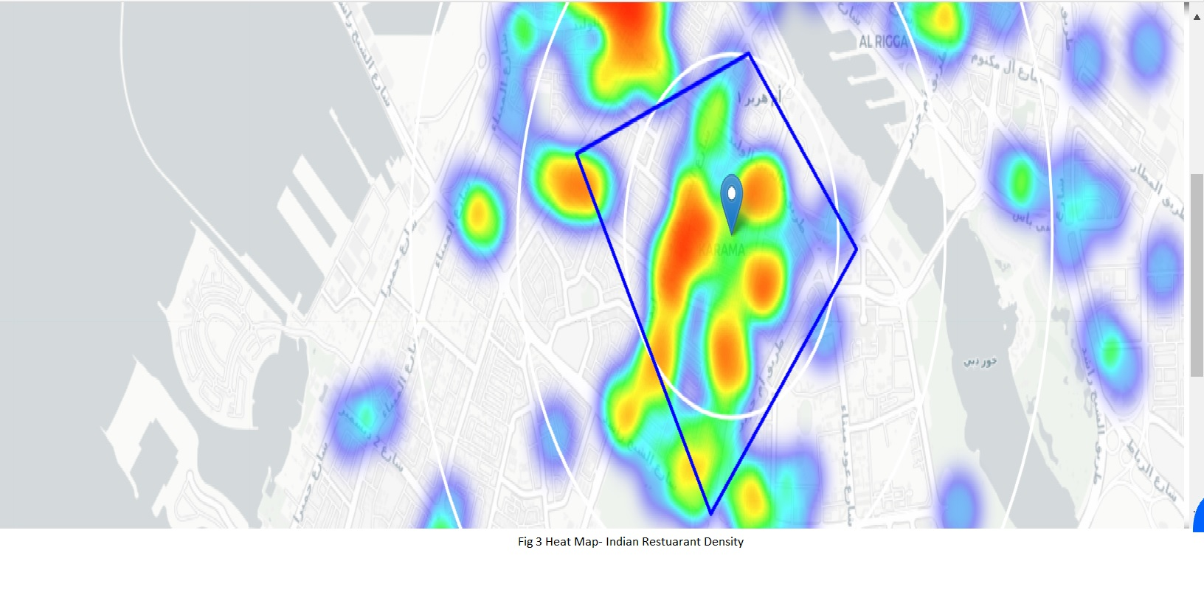
density of Indian restuarants in Al karama

Slide 8
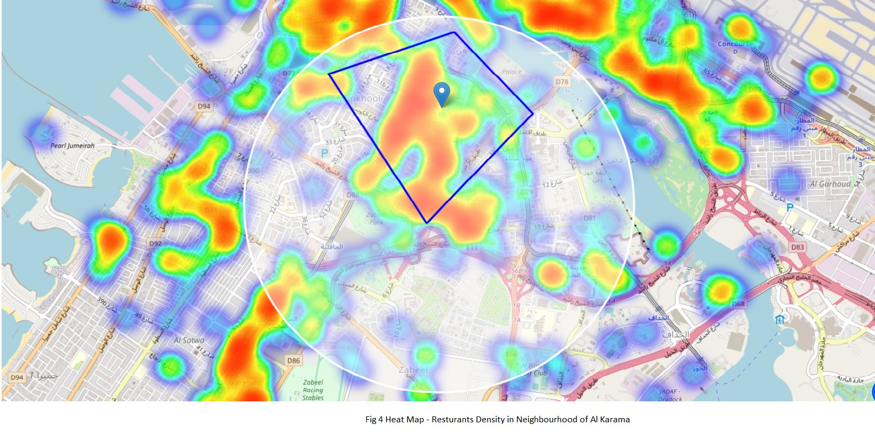
density of resturants in Al karama Neighborhood

Slide 9
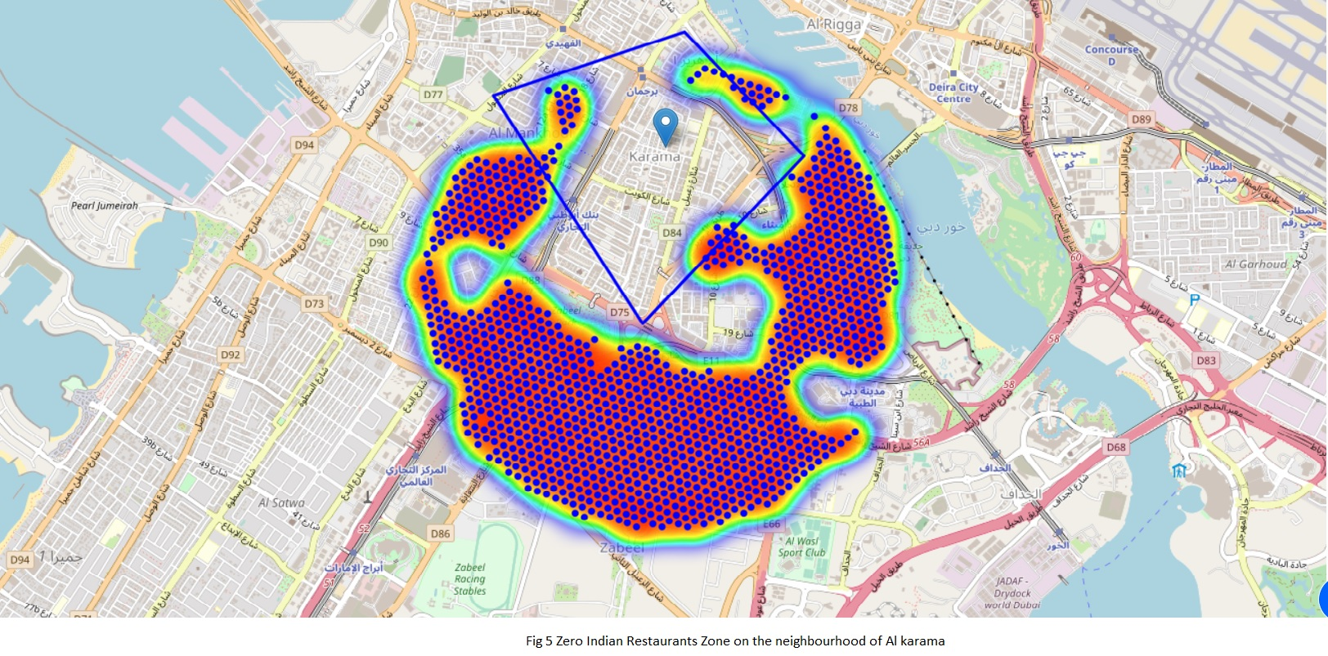
Zero Indian resturants Zone in Al karama Neighborhood

Slide 10
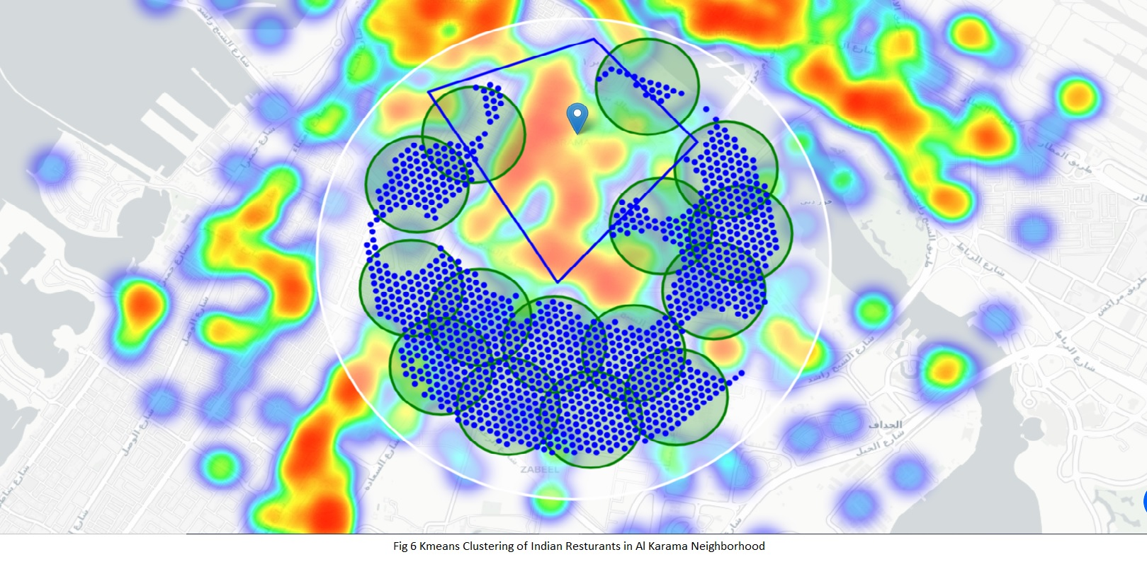
KMeans Clustering of restaurants in Al karama Neighborhood

Slide 11
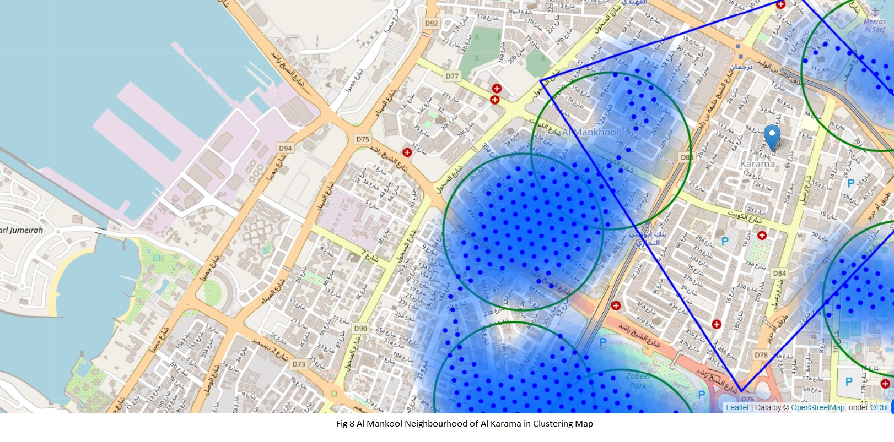
K Means Clustering without heat map-Al Mankool

Slide 12
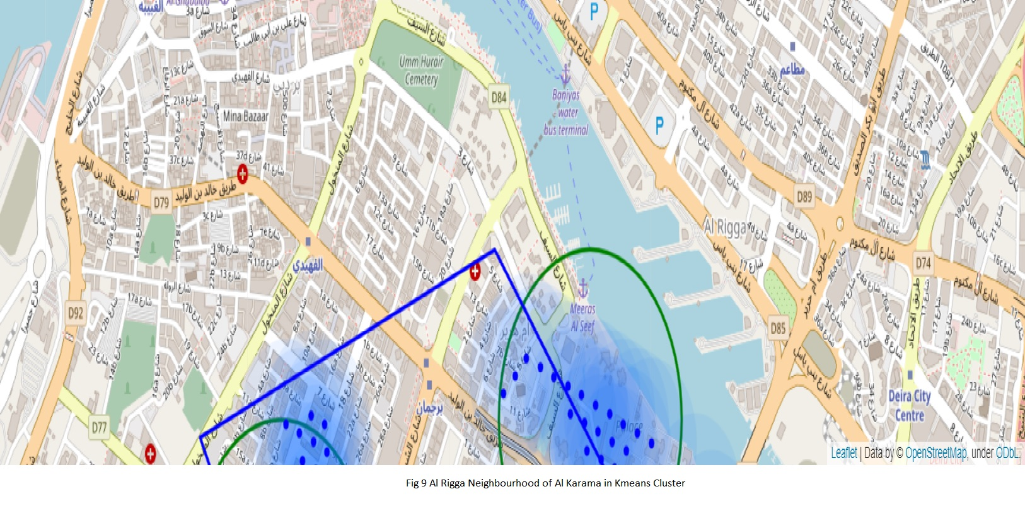
K Means Clustering without heat map-Al rigga

Slide 13
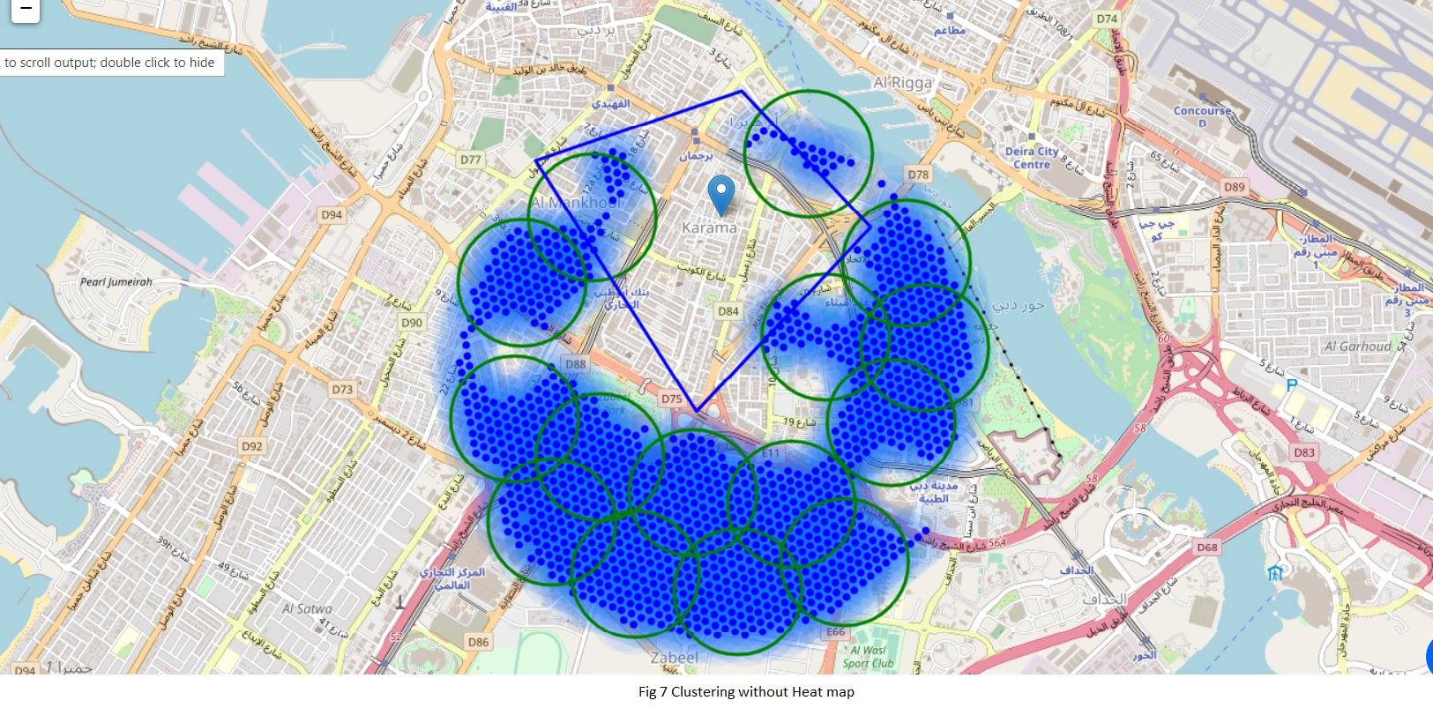
K Means Clustering in Al karama Neighborhood

Slide 14
Results and Discussion
Highest concentration of restaurants was detected north and west from Al Karama.
Our attention was focused on Al Mankool and Al Rigga.
offer a combination of popularity among tourists, closeness to city center, strong socio-economic dynamics
Another borough was identified as potentially interesting – AL Zabeel.
Recommended zones should therefore be considered only as a starting point for more detailed analysis which could eventually result in location

Slide 15
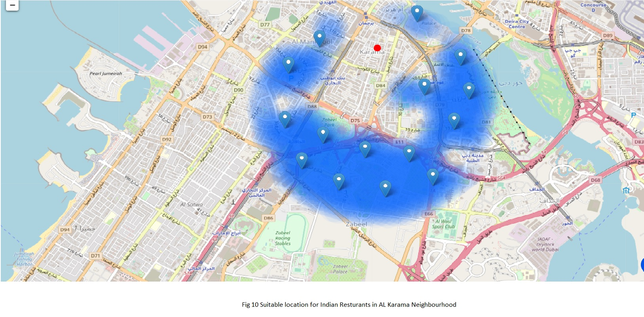
Best Locations for new Indian resturants in neighborhood

Slide 16
Conclusion
Purpose of this project was to identify Dubai areas close to center with low number of restaurants (particularly Indian restaurants) .
By calculating restaurant density distribution from Foursquare data we have first identified general boroughs that justify further analysis (Al Mankool and Al Rigga).
Clustering of those locations was then performed in order to create major zones of interest (containing greatest number of potential locations) .
Final decision on optimal restaurant location will be made by stakeholders based on specific characteristics of neighborhoods and locations in every recommended zone.

